Slide 1
Chapter 9:
Data Warehousing
Modern Database Management
10th Edition
Jeffrey A. Hoffer, V. Ramesh,
Heikki Topi
© 2011 Pearson Education, Inc. Publishing as Prentice Hall

Slide 2
Definition
Data Warehouse
  A subject-oriented, integrated, time-variant, non-updatable collection of data used in support of management decision-making processes
    Subject-oriented: e.g. customers, patients, students, products
    Integrated: consistent naming conventions, formats, encoding structures; from multiple data sources
    Time-variant: can study trends and changes
    Non-updatable: read-only, periodically refreshed
Data Mart
  A data warehouse that is limited in scope
Notes:
DW - a large DB store to guide management decisions.
is a system used for reporting and data analysis, and is considered a core component of business intelligence.
A data mart that is limited in scope
Unlike operational system, DW is subject oriented to make useful for decision makers.
Integrated – different sources, info needs to be integrated, same naming convention
Time is important -> analysis of trends of time. To predict the future you must understand the past

Slide 3
Need for Data Warehousing
Integrated, company-wide view of high-quality information (from disparate databases)
Separation of operational and informational systems and data (for improved performance)
Notes:
“Single Version of Truth”
Data in operational systems are not consistent. You may have different vendors for different parts of your operational systems!
There is a need to have a wider view of the company!
Running analytical queries on top of operational system is not advisable, they are build for different purpose. The info is not organized to achieve that.

Slide 4
Organizational Trends Motivating Data Warehouses
No single system of records
Multiple systems not synchronized
Organizational need to analyze activities in a balanced way
Customer relationship management
Supplier relationship management
Notes:
Organizations saw that there isn’t one place to get “One version of the truth”!!!
Multiple systems aren’t integrated. Specially in the case on M and A, you may have two system with customer information. If you want to do wholistic customer analysis, you can’t
Wholistic analysis of the value change from supply chain management to CRM.

Slide 5
Separating Operational and Informational Systems
Operational system – a system that is used to run a business in real time, based on current data; also called a system of record
Informational system – a system designed to support decision making based on historical point-in-time and prediction data for complex queries or data-mining applications
Notes:
They way operational systems are build, they are build to be the system of record, and run the operations.
Informational systems is designed to support decision making

Slide 6
Data Warehouse Architectures
Independent Data Mart
Dependent Data Mart and Operational Data Store
Logical Data Mart and Real-Time Data Warehouse
Three-Layer architecture
All involve some form of extract, transform and load (ETL)

Slide 7
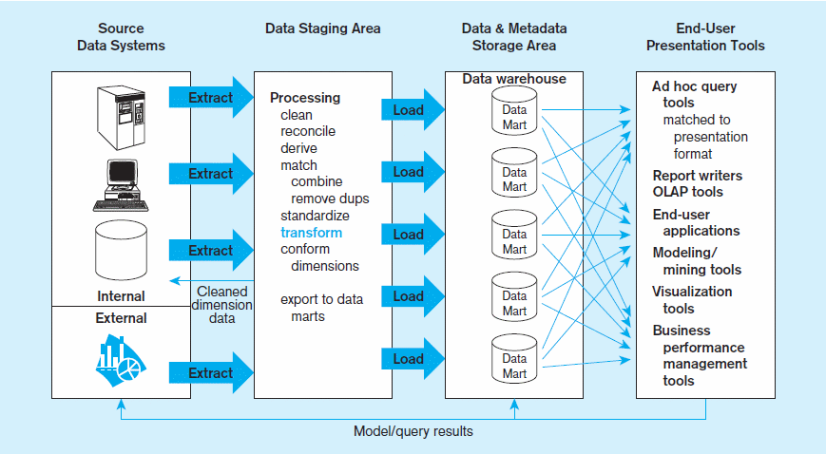
Figure 9-2 Independent data mart data warehousing architecture
Data marts:
Mini-warehouses, limited in scope
L
T
E
Separate ETL for each independent data mart
Data access complexity due to multiple data marts
Notes:
What is the advantage of this model:
Time, phased approach. You can take t your time to do 1 data mart at a time.
Disadvantage, no enterprise view of the organization. Data still isn’t centralized

Slide 8
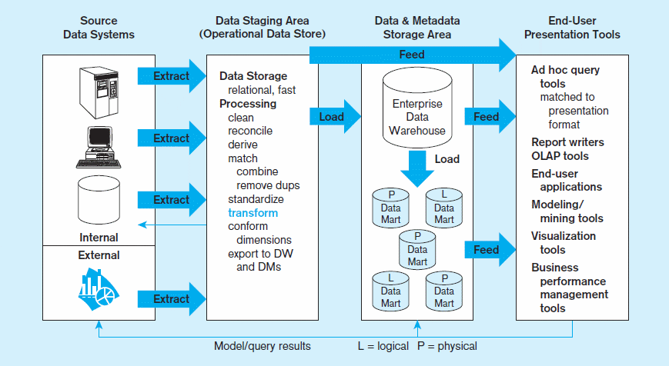
Figure 9-3 Dependent data mart with operational data store: a three-level architecture
ODS provides option for obtaining current data
L
T
E
Simpler data access
Single ETL for
enterprise data warehouse (EDW)
Dependent data marts loaded from EDW
Notes:
Advantage: single view of the organization, data centralized in EDW.
Disadvantage : takes longer to implement.
OLAP – Online Analytical processing

Slide 9
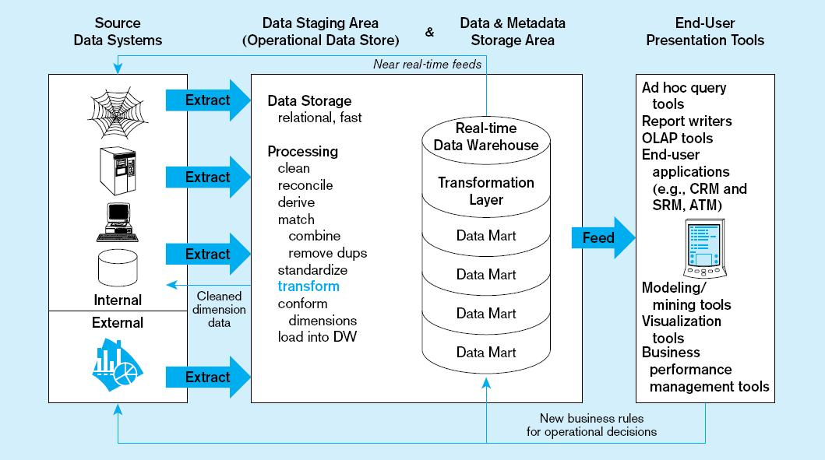
Figure 9-4 Logical data mart and real time warehouse architecture
ODS and data warehouse are one and the same
L
T
E
Data marts are NOT separate databases, but logical views of the data warehouse
➔ Easier to create new data marts
Near real-time ETL for
Data Warehouse
Notes:
Near real time feed to DW.
Advantages: real time data, save on storage.
Dissaving: need powerful machines. ExaData, Neteza, TerraData

Slide 10
Derived Data
Objectives
  Ease of use for decision support applications
  Fast response to predefined user queries
  Customized data for particular target audiences
  Ad-hoc query support
  Data mining capabilities
Characteristics
  Detailed (mostly periodic) data
  Aggregate (for summary)
  Distributed (to departmental servers)
Most common data model = star schema
(also called “dimensional model”)
Notes:
Derived data - formatted, and aggregated for end-user decision support applications. Data marts are created from derived data
A lot of the data in DW, is not stored the same way as operational. Data can be derived:

Slide 11
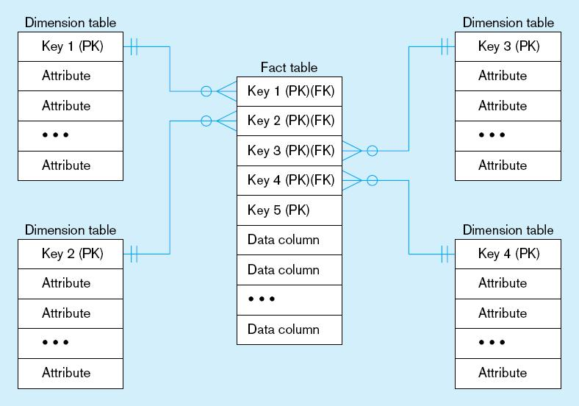
Figure 9-9 Components of a star schema
Fact tables contain factual or quantitative data
1:N relationship between dimension tables and fact tables
Dimension tables are denormalized to maximize performance
Dimension tables contain descriptions about the subjects of the business
Excellent for ad-hoc queries, but bad for online transaction processing
Notes:
FACT Table - contains factual or quantitative data
Dimension table – descriptions of subject of the business

Slide 12
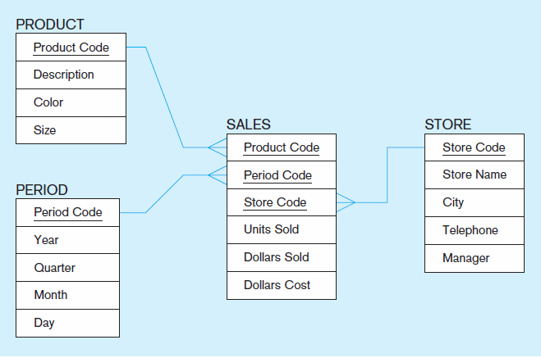
Figure 9-10 Star schema example
Fact table provides statistics for sales broken down by product, period and store dimensions
Notes:
Sales FACT – info about quantity and amounts sold and cost
DIM – product period , and store.
What kind of questions can we ask?
Show trends per product/ per location
show products that is more profitable
Show fastest growing segment of the business, where are we selling the them

Slide 13
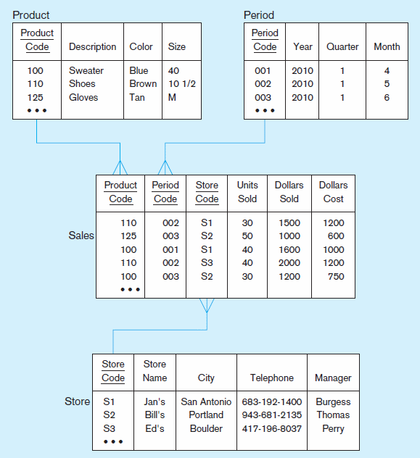
Figure 9-11 Star schema with sample data
Notes:
In this example here, which table is a FACT, which are Dim?
Two types of attributes in sales Fact: FK, and numeric values for the quantifies
Dimension tables – enough attributes to define the business description

Slide 14
Surrogate Dimension Keys
Dimension table keys should be surrogate (non-intelligent and non-business related), because:
  Business keys may change over time
  Helps keep track of nonkey attribute values for a given production key
  Surrogate keys are simpler and shorter
  Surrogate keys can be same length and format for all keys
Notes:
The relationship between FACT and DIM is done via a surrogate key.
Business keys may change over time -> in operational system keys may change
Helps keep track of nonkey attribute values for a given production key -? Non key attribute changes such as marriage for example last name changes
Surrogate keys are simpler and shorter
Surrogate keys can be same length and format for all keys

Slide 15
Grain of the Fact Table
Granularity of Fact Table–what level of detail do you want?
  Transactional grain–finest level
  Aggregated grain–more summarized
  Finer grains ➔ better market basket analysis capability
  Finer grain ➔ more dimension tables, more rows in fact table
  In Web-based commerce, finest granularity is a click
Notes:
How granular do you want to design your FACT table to be?
The more granular the data, more records will have.
In telecom, ca call record is the most granular, you may want to summarize by TN and Date!!
More granular is typically better, however it is more work

Slide 16
Duration of the Database
  Natural duration–13 months or 5 quarters
  Financial institutions may need longer duration
  Older data is more difficult to source and cleanse
Notes:
13 months enables you do trend analysis.
You may have to keep more data due to compliance. In Telecom we are required to have 7 years of calling records

Slide 17
Variations of the Star Schema
Multiple Facts Tables
  Can improve performance
  Often used to store facts for different combinations of dimensions
  Conformed dimensions
Factless Facts Tables
  No nonkey data, but foreign keys for associated dimensions
  Used for:
    Tracking events
    Inventory coverage
Notes:
For bigger systems:
Multiple Facts Tables -> perhaps one fact table to measure different aspect, division. Some companies have business that are completely different, in that case you may need different dimension
Factless Facts Tables -> for measure events. Something either happened or didn’t happen

Slide 18
Normalizing Dimension Tables
Multivalued Dimensions
  Facts qualified by a set of values for the same business subject
  Normalization involves creating a table for an associative entity between dimensions
Hierarchies
  Sometimes a dimension forms a natural, fixed depth hierarchy
  Design options
    Include all information for each level in a single denormalized table
    Normalize the dimension into a nested set of 1:M table relationships
Notes:
Remove

Slide 19
Slowly Changing Dimensions (SCD)
Need to maintain knowledge of the past
One option: for each changing attribute, create a current value field and many old-valued fields (multivalued)
Better option: create a new dimension table row each time the dimension object changes, with all dimension characteristics at the time of change
Notes:
The process of capturing dimension changes over time is called SCD! Example might be a person chaging their last name.
Draw an example of person’s getting married change
When dimensions are normalized, it is called a snowflake as opposed to a start schema

Slide 20
Example of SCD Type 2
Records from operational system
EmpID | FirstName | LastName | Address | StartDate
E100 | Joseph | Smith | 101 Main St | 1/1/2019
E200 | Raj | Boopathy | 30 Ames Ave | 2/2/2019
E300 | Sarah | Lee | 15 Water St | 2/15/2019

Slide 21
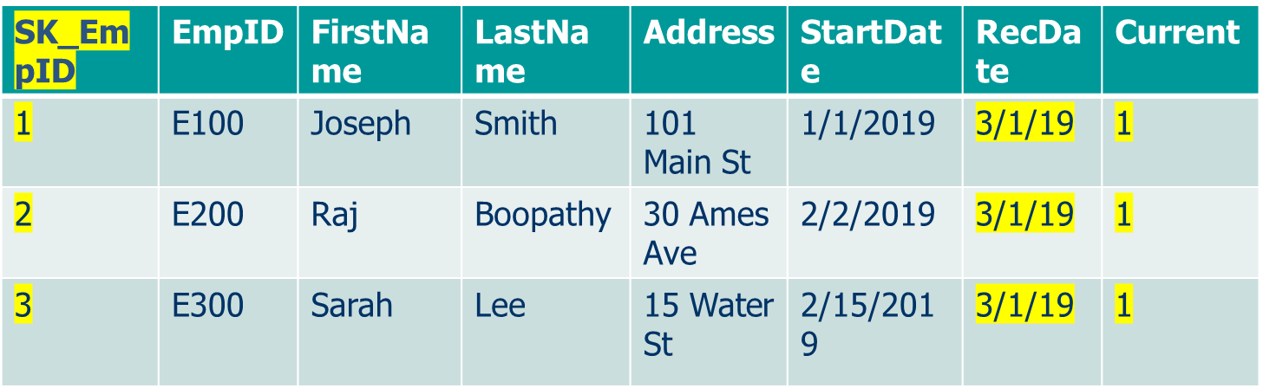
Example of SCD Type 2
Records from operational system
EmpID | FirstName | LastName | Address | StartDate
E100 | Joseph | Smith | 101 Main St | 1/1/2019
E200 | Raj | Boopathy | 30 Ames Ave | 2/2/2019
E300 | Sarah | Lee | 15 Water St | 2/15/2019
Records from the Employee Dimension

Slide 22
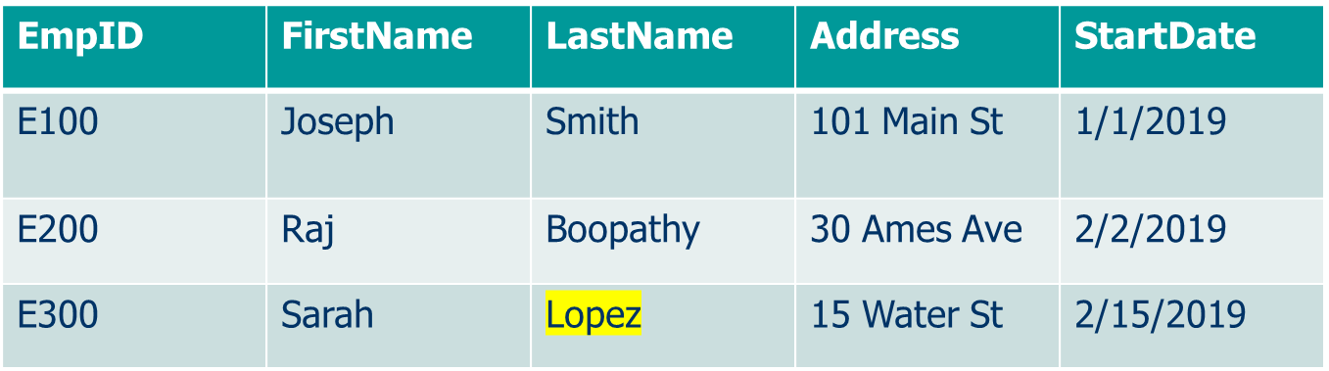
Operational System changes
Records from operational system 3/14/19
Sarah gets married, last name changes to from Lee to Lopez

Slide 23
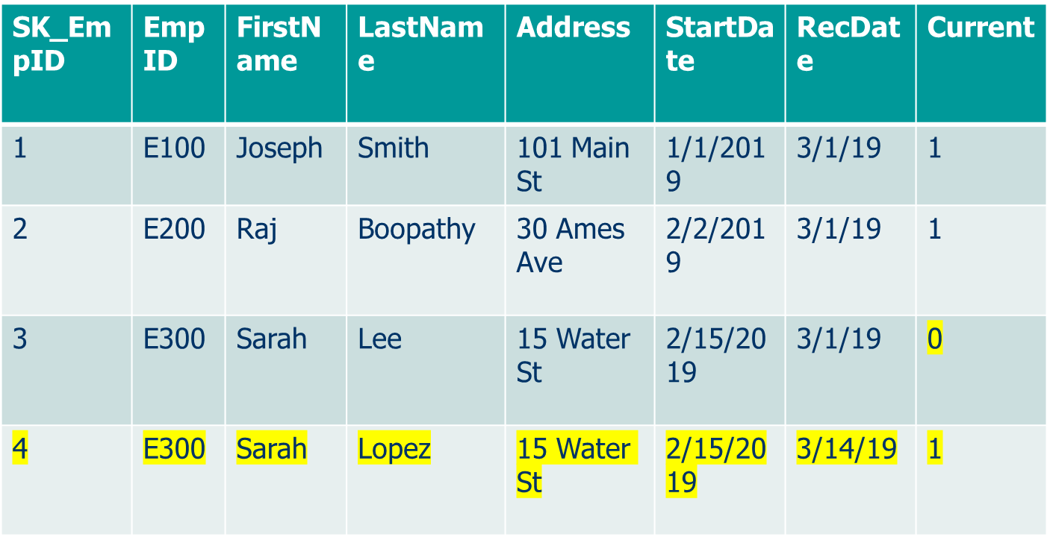
Processing changes
Records from the Employee Dimension

Slide 24
Online Analytical Processing (OLAP) Tools
The use of a set of graphical tools that provides users with multidimensional views of their data and allows them to analyze the data using simple windowing techniques
Modes:
  Relational OLAP (ROLAP)
  Multidimensional OLAP (MOLAP)
Cube structure
OLAP Operations
  Cube slicing–come up with 2-D view of data
  Drill-down–going from summary to more detailed views
  Consolidation - roll up operations
Notes:
OLAP – Online Analytical processing Tool - tool to provide multi dimensional view of the Data.
Microsoft has an OLAP tool called SSAS

Slide 25
OLAP Tools
IBM Cognos
Microstrategy
Palo OLAP Server
Apache Kylin
Microsoft SSAS
Notes:
OLAP – Online Analytical processing Tool - tool to provide multi dimensional view of the Data.
Microsoft has an OLAP tool called SSAS

Slide 26
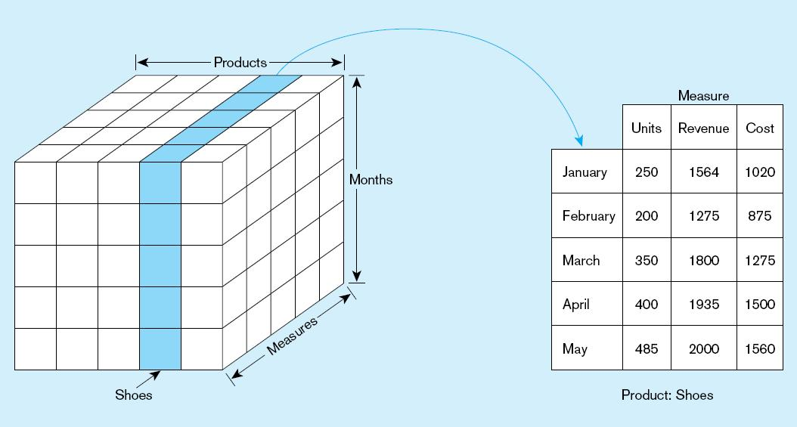
  Figure 9-21 Slicing a data cube
Notes:
The function of slicing and dicing is a process in which data is viewed in two dimensional modeling!
You have your measures, and your dimensions

Slide 27
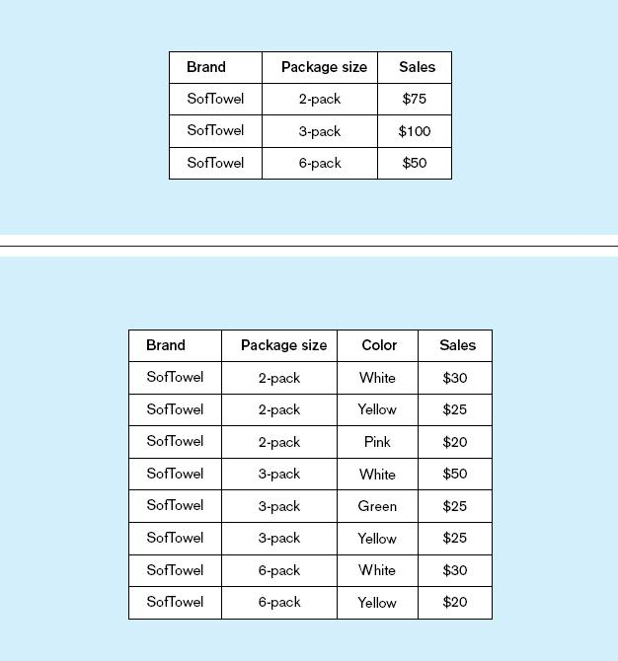
Summary report
Figure 9-22
Example of drill-down
Starting with summary data, users can obtain details for particular cells
Drill-down with color added
Notes:
Starting with summary data, click -through to view details

Slide 28
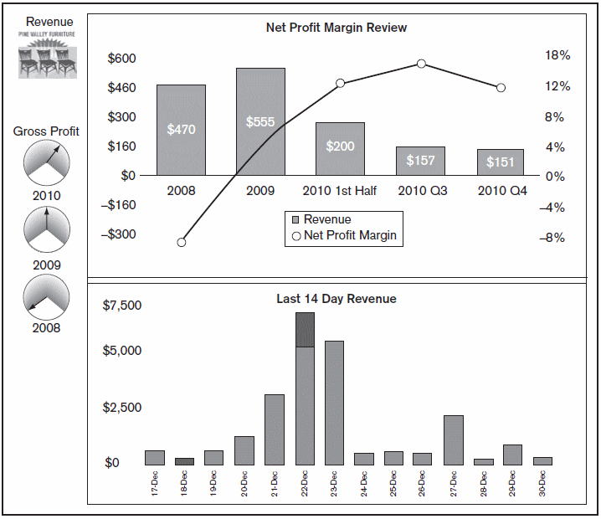
Business Performance Mgmt (BPM)
Figure 9-25
Sample Dashboard
BPM systems allow managers to measure,
monitor, and manage key activities and processes to achieve organizational goals.
Dashboards are often used to provide an information system in support of BPM.
Charts like these are examples of data visualization, the representation of data in graphical and multimedia formats for human analysis.
Notes:
BPM – are KPI that measures the business performance of a particular process.
Data presented as graphs is easier to read for human consuption

Slide 29
Data Mining
Knowledge discovery using a blend of statistical, AI, and computer graphics techniques
Goals:
  Explain observed events or conditions
  Confirm hypotheses
  Explore data for new or unexpected relationships
Notes:
Using Statistical Techniques, Data Analysists and Scientifics can mine the data

Slide 30
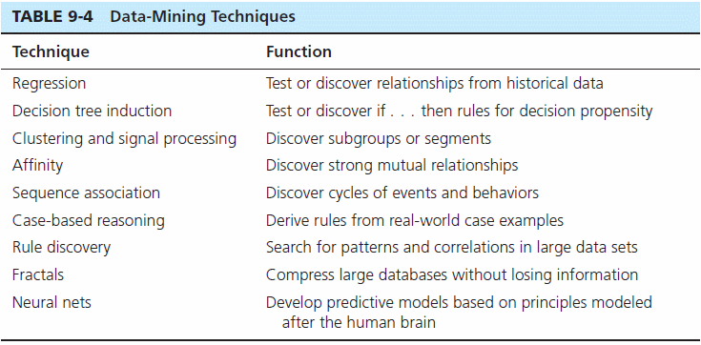
Notes:
Regression models – linear non linear regressions
Decision Trees
Clustering

